Slide 1
The skeletal system
AEHBY ATAR Human Biology

Slide 2
Review
Sketch a muscle under contraction, using the sliding filament model.
Explain the difference in structure and function of the large intestine and small intestine.
Describe the mechanisms and structures involved in external respiration.
Give an example of a substance that is transported across cell membranes by a) simple diffusion, b) facilitated diffusion, c) carrier mediated active transport and d) phagocytosis.

Slide 3
Learning Intentions
The skeletal framework of the body consists of bone and cartilage which function to provide body support, protection and movement.

Slide 4
Success Criteria
List or describe the functions of the skeletal system.
Label a diagram of a long bone.
Classify bones of the skeleton as axial or appendicular.
Classify bones by shape.

Slide 5
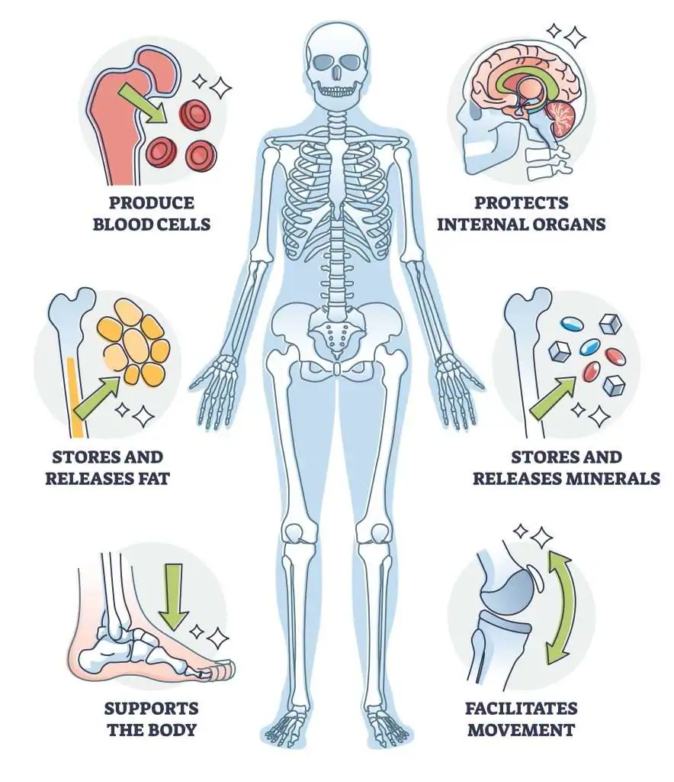
Functions of the skeletal system
Support
Protection
Allow movement
Storage for minerals and fat
Blood cell production

Slide 6
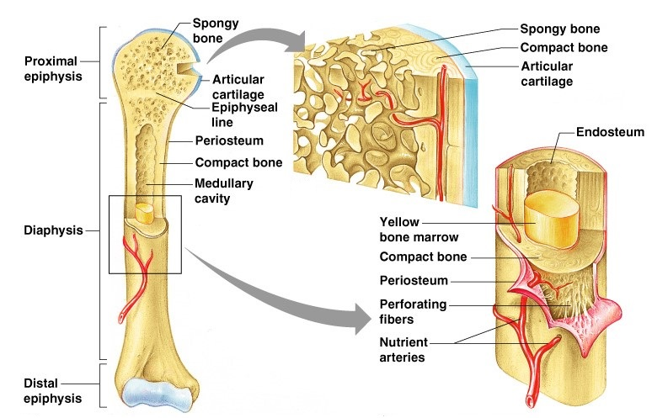

Slide 7
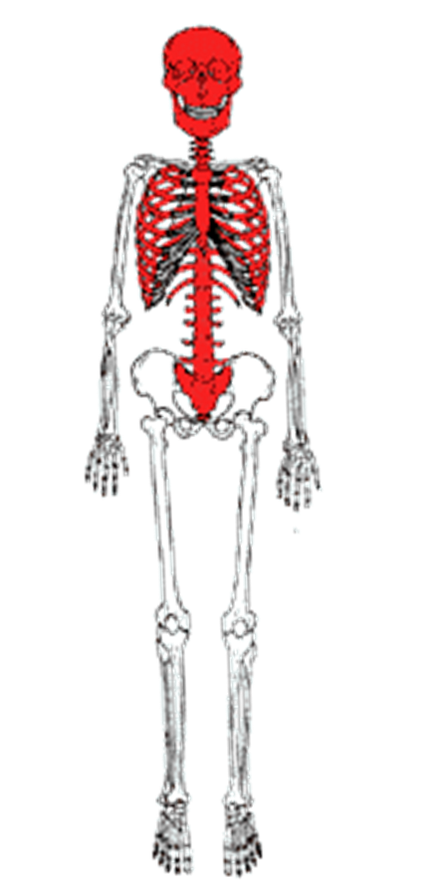
Axial skeleton
Consist of:
Skull
Spine
Ribs
Sternum

Slide 8
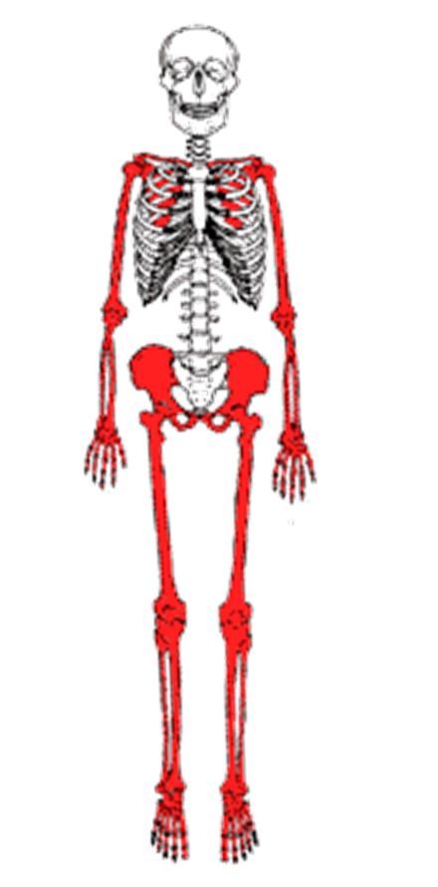
Appendicular skeleton
Consist of the bones that make up the arms and legs (appendages) and girdles, which attach them to the rest of the body.

Slide 9
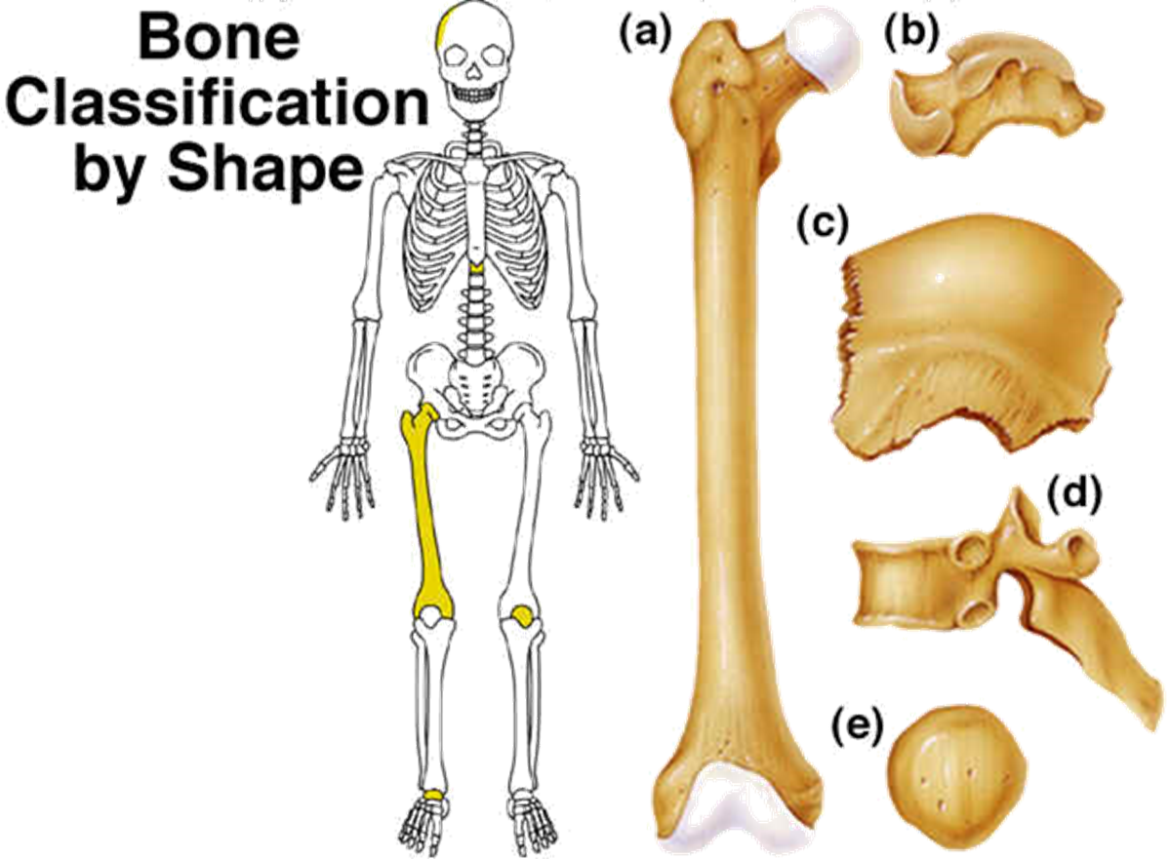
a) Long bones
b) Short bones
c) Flat Bones
d) Irregular bones
e) Sesamoid bones

Slide 11
Success Criteria
List or describe the functions of the skeletal system.
Label a diagram of a long bone.
Classify bones of the skeleton as axial or appendicular.
Classify bones by shape.

